Slide 1
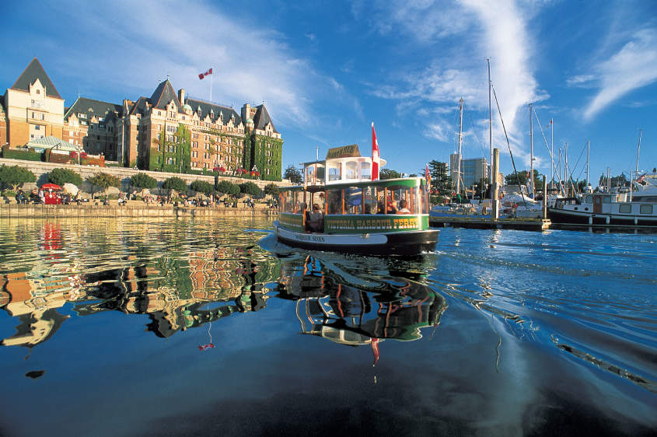
CANSSI Ferry Delay
Team UTalent
Yuxin Shi, Yitian Zhang, Yanlin Li

Slide 2
Introduction
Major steps:
Data cleaning
Model fitting
Prediction
Remaining Issue & Resolution
Application
Concerns

Slide 3
1. Data cleaning
Variable Selection
Select coincident time period
Add ‘match_time’ variable representing date and time
Drop ‘weather’ & ‘status’ variables to simplify models
Divide start points into three categories and add a variable representing start location
Data Merging
Using Excel
Merge corresponding to ‘match_time’ variable
Merge traffic with horseshoe as traffic only related to horseshoe
Merge datasets with the same start location

Slide 4
Missing Values
Drop ‘Humidex.in.Celsius’ as too many missing values
Use per hour average to represent missing values

Slide 5
2. Model Fitting
Three different Models
Different design matrices(model performance may diverse)
Logistic regression in SAS
2-outcome result
Familiar model
Quickly with SAS code
Correlation

Slide 6
/*Do 3 logistic regressions*/
proc corr data=horseshoe_join; var avg_traffic_ordinal avg_temperature avg_dew_point avg_relative_humidity_in_percent ;
proc logistic data=horseshoe_join des outest=betas_1; model delay_indicator = avg_traffic_ordinal /*avg_temperature*/ /*avg_dew_point*/
avg_relative_humidity_in_percent avg_temperature*avg_dew_point /*avg_relative_humidity_in_percent*avg_dew_point*/ ;

Slide 7
3. Prediction
Fitting the model to test statistics
Score in SAS

Slide 8
/*Predict horseshoe test data*/
proc score data=horseshoe_test_join out=horseshoe_predict score=betas_1 type=parms;
var avg_traffic_ordinal avg_relative_humidity_in_percent avg_temperatureavg_dew_point ;
data horseshoe_predict; set horseshoe_predict;
p_delay = 1/(1+exp(-delay_indicator)); keep ID p_delay;

Slide 9
Remaining Issue
Data usage and separate models
Variable selection and model selection(more on muticolinearity)
Advanced model(Ridge/Principle component regression, Lasso, etc)

Slide 10
Application
How to apply this research to the prediction of future ferry delay
Identifying main cause of delay
Avoid future delay
Forecast the delay

Slide 11
Concerns
What does delay mean? Arrival delay or departure delay?
Location not precise
Most variables intuitively insignificant

Slide 12
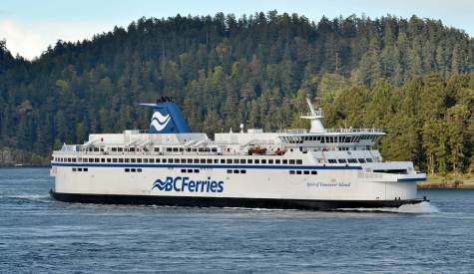
Thank you!

